Slide 1
Input/Output Organization <number>
Overview
Peripheral Devices
Input-Output Interface
Asynchronous Data Transfer
Modes of Transfer
Priority Interrupt
Direct Memory Access
Input-Output Processor
Serial Communication

Slide 2
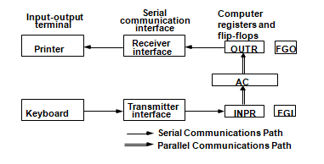

Slide 3
Input/Output Organization <number>
Input Output Organization
  I/O Subsystem
    Provides an efficient mode of communication between the central system and the outside environment
  Programs and data must be entered into computer memory for processing and results obtained from computer must be recorded and displayed to user.
  When input transferred via slow keyboard processor will be idle most of the time waiting for information to arrive
      Magnetic tapes, disks

Slide 4
Input/Output Organization <number>
Peripheral Devices
Devices that are under direct control of computer are said to be connected on-line.
Input or output devices attached to the computer are also called peripherals.
There are three types of peripherals :
  Input peripherals
  Output peripherals
  Input-output peripherals
  Peripheral (or I/O Device)
      Monitor (Visual Output Device) : CRT, LCD
      KeyBoard (Input Device) : light pen, mouse, touch screen, joy stick, digitizer
      Printer (Hard Copy Device) : Daisy wheel, dot matrix and laser printer
      Storage Device : Magnetic tape, magnetic disk, optical disk

Slide 5

Q- Input or output devices attached to the computer are called
A- ITEMS
B- SORCES
C- PERIPHERALS
D- GADGETS

Slide 6
Input/Output Organization <number>
Peripheral Devices
Input Devices
Output Devices
Keyboard
Optical input devices
- Card Reader
- Paper Tape Reader
- Bar code reader
- Optical Mark Reader
Magnetic Input Devices
- Magnetic Stripe Reader
Screen Input Devices
- Touch Screen
- Light Pen
- Mouse
Card Puncher, Paper Tape Puncher
CRT
Printer (Daisy Wheel, Dot Matrix, Laser)
Plotter

Slide 7
Input/Output Organization <number>
Input Output Organization
  ASCII (American Standard Code for Information Interchange)
    I/O communications usually involves transfer of alphanumeric
    information from the device and the computer.
    Standard binary code for alphanumeric character is ASCII
    ASCII Code :
      It uses 7 bits to code 128 characters (94 printable and 34 non printing)
      7 bit - 00 - 7F ( 0 - 127 )
    ASCII is 7 bits but most computers manipulate 8 bit quantity as a
    single unit called byte.
        80 - FF ( 128 - 255 ) : Greek, Italic type font

Slide 8
Input/Output Organization <number>
Input Output Organization
  ASCII (American Standard Code for Information Interchange)
Printable ASCII characters
http://facweb.cs.depaul.edu/sjost/it212/documents/ascii-pr.htm
Non-Printable ASCII characters
https://web.itu.edu.tr/sgunduz/courses/mikroisl/ascii.html

Slide 9
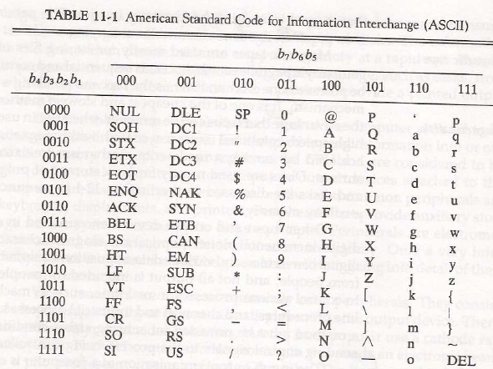

Slide 10
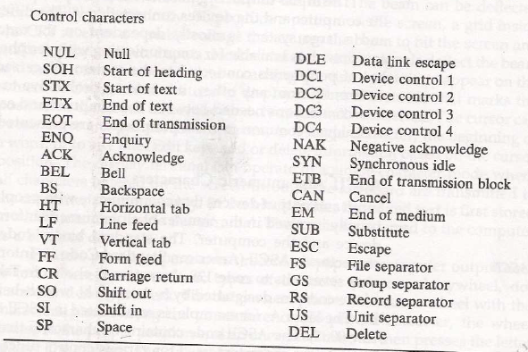

Slide 11
    Three types of control characters: Format effectors, Information separators and communication control
Format Effectors: control the layout of printing. They include familiar typewriter controls, such as backspace (BS), horizontal tabulation(HT), carriage return(CR).
Information separators: used to separate data into divisions like paragraphs and pages. They include characters such as record separator (RS) and file separator(FS).
Communication Control characters: these are useful during the transmission of text between remote terminals. These include STX(Start of text) and ETX(end of text)

Slide 12
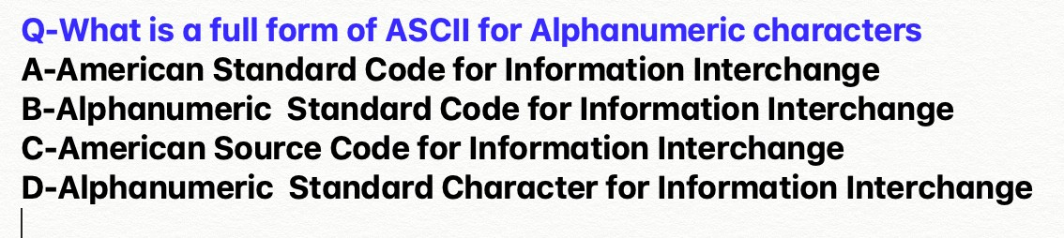

Slide 13
Input/Output Organization <number>
I/O Interface
Provides a method for transferring information between internal storage (such as memory and CPU registers) and external I/O devices
Resolves the differences between the computer and peripheral devices
  (1). Peripherals – Electromechanical or Electromagnetic Devices
  CPU or Memory - Electronic Device
      Conversion of signal values required
  (2). Data Transfer Rate
    Peripherals - Usually slower
    CPU or Memory - Usually faster than peripherals
      Some kinds of Synchronization mechanism may be needed
  (3). Data formats or Unit of Information
    Peripherals – Byte, Block, …
    CPU or Memory – Word
  (4). Operating modes of peripherals may differ
    must be controlled so that not to disturbed other peripherals connected to CPU

Slide 14
Input/Output Organization <number>
I/O Bus and Interface
I/O bus
Data
Processor
Address
Control
Interface
Interface
Interface
Interface
Keyboard
Magnetic
Magnetic
and
Printer
disk
tape
display
terminal
Interface :
- Decodes the device address (device code)
- Decodes the commands (operation)
- Provides signals for the peripheral controller
- Synchronizes the data flow and supervises
the transfer rate between peripheral and CPU or Memory
4 types of command interface can receive : control, status, data o/p and data i/p

Slide 15
Input/Output Organization <number>
I/O Bus and Interface
Control command : is issued to activate peripheral and to inform what to do
Status command : used to test various status condition in the interface and
the peripherals
data o/p command : causes the interface to respond by transferring data from
the bus into one of its registers
data i/p command : interface receives an item of data from the peripheral and
places it in its buffer register.

Slide 16
Input/Output Organization <number>
I/O Bus and Memory Bus
Functions of Buses
  MEMORY BUS is for information transfers between CPU and the MM
  I/O BUS is for information transfers between CPU and I/O devices through their I/O interface
  3 ways to bus can communicate with memory and I/O :
  (1). use two separate buses, one to communicate with memory and the
  other with I/O interfaces
  - Computer has independent set of data, address and control bus one for
  accessing memory and another I/O.
  - done in computers that have separate IOP other than CPU.
  (2). Use one common bus for memory and I/O but separate control lines
  for each
  (3). Use one common bus for memory and I/O with common control
  lines for both

Slide 17
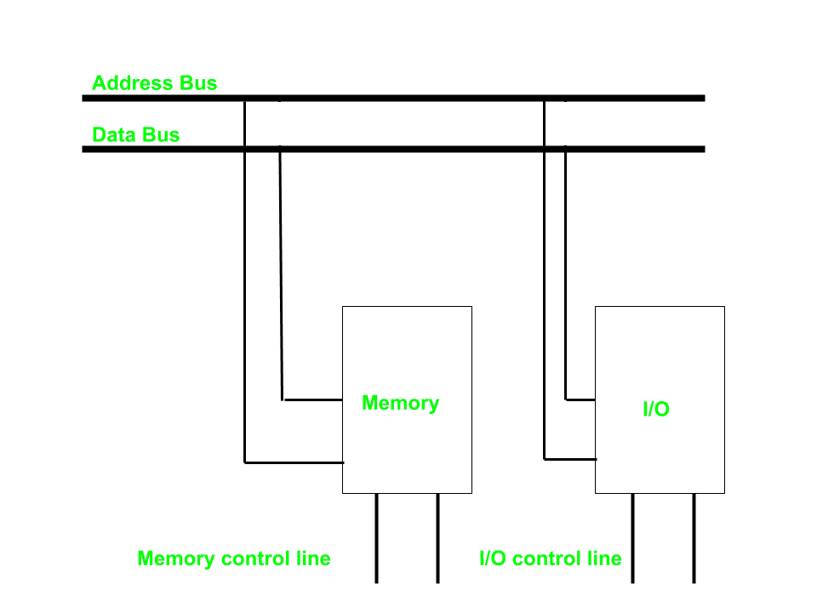
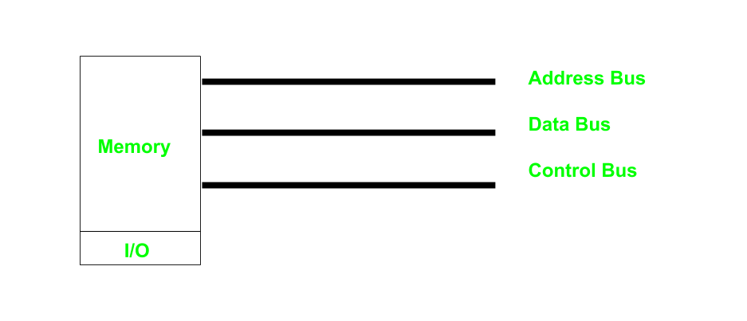

Slide 18
Input/Output Organization <number>
Isolated vs. Memory Mapped I/O
Isolated I/O
- Many computers use common bus to transfer information between memory or I/O.
- The distinction between memory transfer and I/O transfer is made through separate read and write line.
-In the isolated I/O configuration , the CPU has distinct input and output instructions and each of these instruction is associated with the address of an interface register.
Distinct input and output instructions -each associated with address of interface register
Memory-mapped I/O
  - A single set of read/write control lines
  (no distinction between memory and I/O transfer)
  - Memory and I/O addresses share the common address space
  -> reduces memory address range available
  - No specific input or output instruction
  -> The same memory reference instructions can
  be used for I/O transfers
  - Considerable flexibility in handling I/O operations

Slide 19
Isolated vs. Memory Mapped I/O
Memory-mapped I/O
A single set of read/write control lines
(no distinction between memory and I/O
transfer)
Memory and I/O addresses share the common address space
-> reduces memory address range available
No specific input or output instruction
-> The same memory reference instructions can be used for I/O transfers
Considerable flexibility in handling I/O operations

Slide 20
Input/Output Organization <number>
I/O Interface
Port A
I/O data
Bidirectional
register
Bus
data bus
buffers
I/O data
Port B
register
CPU
Chip select
I/O
Device
Register select
CS
Internal bus
RS1
Control
Control
Register select
Timing
register
RS0
and
I/O read
Control
I/O write
RD
Status
Status
WR
register
CS RS1 RS0 Register selected
0 x x None - data bus in high-impedence
1 0 0 Port A register
1 0 1 Port B register
1 1 0 Control register
Programmable Interface
1 1 1 Status register
- Information in each port can be assigned a meaning depending on the mode of operation of the I/O device→ Port A = Data; Port B = Command;
- CPU initializes(loads) each port by transferring a byte to the Control Register
→ Allows CPU can define the mode of operation of each port
→ Programmable Port: By changing the bits in the control register, it is possible to change the interface characteristics

Slide 21
The interface registers communicate with the CPU through :-
A-address bus
B-i/o bus
C-bidirectional data bus D-control bus

Slide 22
There are ….. types of commands that an interface may receive.
A- 3
B-4
C-5

